Slide 1

Branch - CSE Python Programming
Lecture – 6 Conditional Execution – Part 1
By
Dr. Smita Tiwari
Assistant Professor
Department of Computer Science and Engineering
School of Engineering & Technology

Slide 2
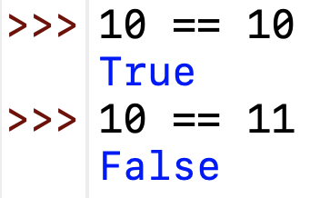
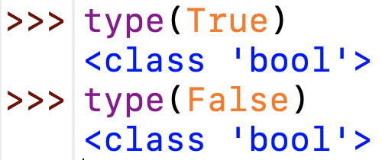
Boolean Expressions (Contd.)
A boolean expression is an expression that is either true or false. The following examples use the operator ==, which compares two operands and produces True if they are equal and False otherwise:
True and False are special values that belong to the class bool ; they are not strings:

Slide 3
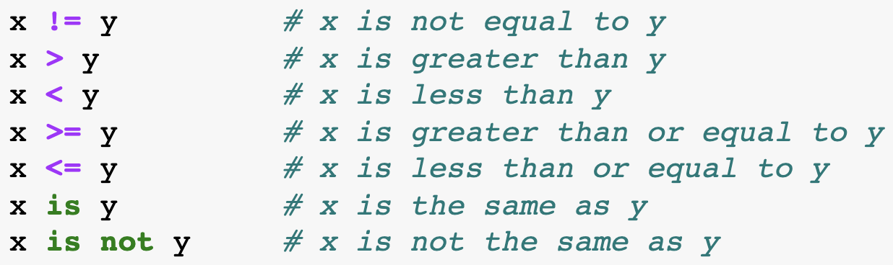
Boolean Expressions (Contd.)
The == operator is one of the comparison operators; the others are:
Although these operations are probably familiar to you, the Python symbols are different from the mathematical symbols for the same operations.

Slide 4
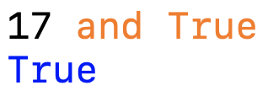
Logical operators
There are three logical operators: and, or, and not. The semantics (meaning) of these operators is like their meaning in English. For example,
x > 0 and x < 10
is true only if x is greater than 0 and less than 10.
n%2 == 0 or n%3 == 0 is true if either of the conditions is true, that is, if the number is divisible by 2 or 3.
Finally, the not operator negates a boolean expression, so not (x > y) is true if x > y is false; that is, if x is less than or equal to y.
Strictly speaking, the operands of the logical operators should be boolean expressions, but Python is not very strict. Any nonzero number is interpreted as “true.”

Slide 5


Conditional Execution (If)
In daily routine
If it is very hot, I will skip exercise.
If there is a quiz tomorrow, I will first study and then sleep. Otherwise, I will sleep now.
If I have to buy coffee, I will go left. Else I will go straight.

Slide 6
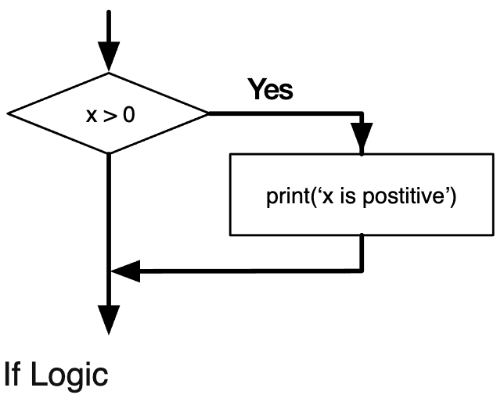
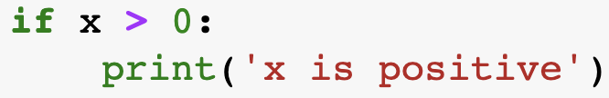
Conditional Execution (If)
In order to write useful programs, we almost always need the ability to check conditions and change the behavior of the program accordingly.
Conditional statements give us this ability.
The simplest form is the if statement:

Slide 7
if-else statement
Compare two integers and print the min.
if x < y:
print (x)
else:
print (y)
print (‘is the minimum’)
Check if x is less than y.
If so, print x
Otherwise, print y.

Slide 8
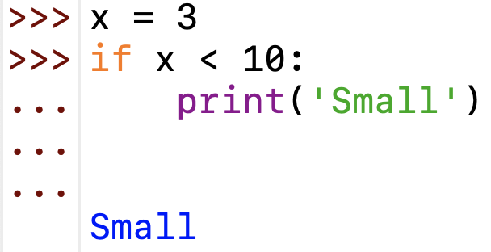
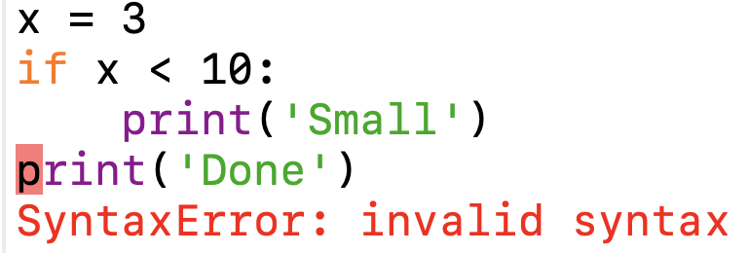
Conditional Execution
If you enter an if statement in the Python interpreter, the prompt will change from three chevrons to three dots to indicate you are in the middle of a block of statements, as shown below:
When using the Python interpreter, you must leave a blank line at the end of a block, otherwise Python will return an error:
This error is called the Indentation Error. Since there is no { } (curly brackets) to show the start and end of a block, Python uses the indented line (generally 4 spaces or a tab space) to identify it.

Slide 9
Indentation is important in Python
grouping of statement (block of statements)
no explicit brackets, e.g. { }, to group statements
x,y = 6,10
if x < y:
print (x)
else:
print (y)
print (‘is the min’)
Run the program
x
y
6
10
Output
6
skipped

Slide 10
General form of the if statement
Execution of if statement
First the expression is evaluated.
If it evaluates to a true value, then S1 is executed and then control moves to the S2.
If expression evaluates to false, then control moves to the S2 directly.
if boolean-expr :
S1
S2
true
false
S1
S2

Slide 11
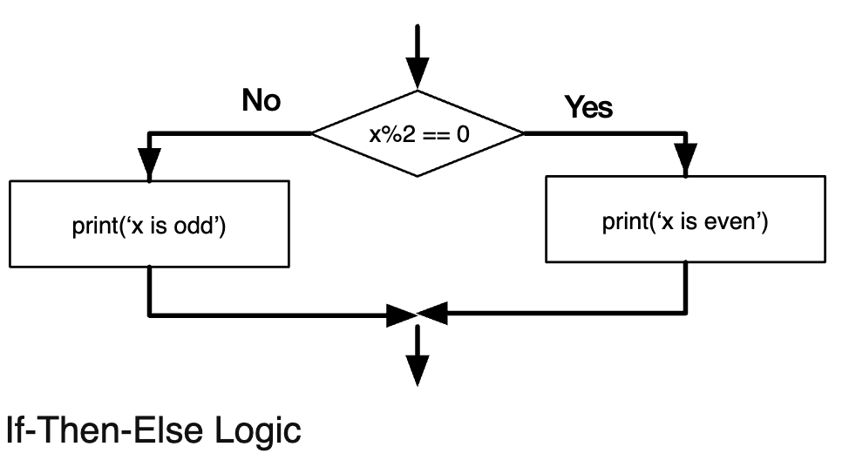
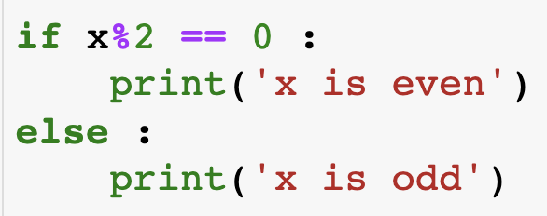
Alternative execution (If-Else)
A second form of the if statement is alternative execution, in which there are two possibilities, and the condition determines which one gets executed. The syntax looks like this:
Since the condition must either be true or false, exactly one of the alternatives will be executed.

Slide 12
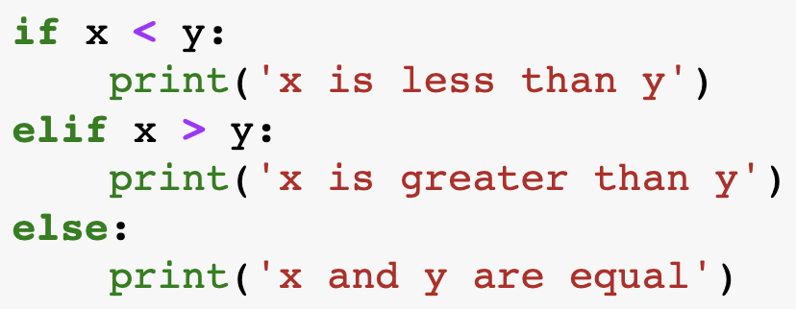
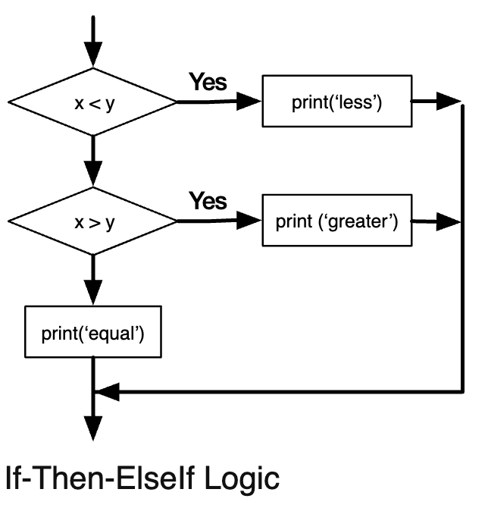
Chained conditionals (If-Else ladder)
Sometimes there are more than two possibilities, and we need more than two branches. One way to express a computation like that is a chained conditional:
elif is an abbreviation of “else if”.
Again, exactly one branch will be executed.

Slide 13
General form of the if-else statement
Execution of if-else statement
First the expression is evaluated.
If it evaluates to a true value, then S1 is executed and then control moves to S3.
If expression evaluates to false, then S2 is executed and then control moves to S3.
S1/S2 can be blocks of statements!
if boolean-expr :
S1
else:
S2
S3
true
false
S1
S2
S3

Slide 14
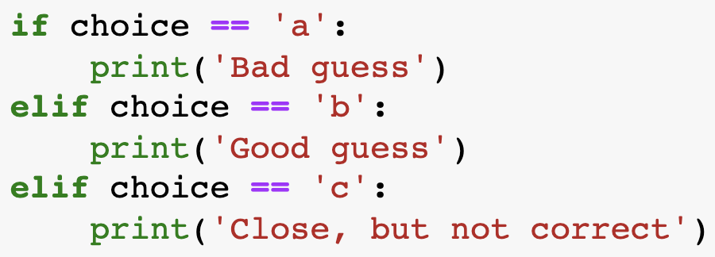
Chained conditionals (If-Else ladder)
There is no limit on the no. of elif statements. If there is an else clause, it must be at the end, but there doesn’t have to be one.

Slide 15
Nested if, if-else
if a <= b:
if a <= c:
…
else:
…
else:
if b <= c) :
…
else:
…

Slide 16
A special kind of nesting is the chain of if-else-if-else-… statements
Can be written elegantly using if-elif-..-else
if cond1:
s1
else:
if cond2:
s2
else:
if cond3:
s3
else:
if cond1:
s1
elif cond2:
s2
elif cond3:
s3
elif …
else :
last-block-of-stmt

Slide 17
THANK YOU

